Slide 1

DSA5101 Project 1
Group 8
Matthew Chia E0540744
Haidi Azaman E0540498
Kho Tze Jit E0535047
Foong Xin Yu E0511018
Liaw Zheng Kai E0560265
Notes:
This is project 1 of dsa 5101 and we are grp 8

Slide 2
Introduction
Notes:
Let’s kick off the introduction with the prob statement and some context

Slide 3
Study Background
Problem Statement:
Select the best model to predict if a client will subscribe to a term deposit in a bank
Context:
A telephone marketing campaign by a Portuguese banking institution to sell term deposits
Notes:
We have defined the prob statement to be “To Select the best model to predict if a client will subscribe to a term deposit in a bank.
And the context of this study is a
A telephone marketing campaign was conducted by a Portuguese banking institution to sell term deposit products to new clients.

Slide 4
Data
Large dataset with 45211 values
16 Attributes, 1 Output
8, Nominal Data - job, marital, default, housing, loan, contact, poutcome, y (output variable)
2, Ordinal Data - month, education
7, Interval/Ratio Data - age, day, month, duration, campaign, pdays, previous
Notes:
Pertaining to the data, we have a large dataset of around 45000 values.
These values can be broken down into 16 attributes.
Under the nominal data, we have
job : states type of job the recipient has
marital : marital status of the recipient
default: binary (binary: "yes","no"), has credit in default?
housing: binary, has housing loan?
loan: binary, has personal loan?
contact: type of communication used, (categorical: "unknown","telephone","cellular")
poutcome: outcome of the previous marketing campaign (categorical: "unknown","other","failure","success")
Output variable (desired target):
17 - y - has the client subscribed a term deposit? (binary: "yes","no")
Under the ordinal data, we have
month: last contact month of year (categorical: "jan", "feb", "mar", ..., "nov", "dec")
education (categorical: "unknown","secondary","primary","tertiary"
Under the interval/ratio data, we have
Age of the recipient (numeric)
day: day of the month contacted (numeric)
month: month of year contacted (categorical: "jan", "feb", "mar", ..., "nov", "dec")
duration: duration of the call, in seconds (numeric)
campaign: number of interactions performed during this campaign for this client (numeric, includes last contact)
pdays: number of days since the client was last contacted (numeric, -1 means client was not previously contacted)
previous: number of contacts performed before this campaign for this client (numeric)
Input variables:
# bank client data:
1 - age (numeric)
2 - job : type of job (categorical: "admin.","unknown","unemployed","management","housemaid","entrepreneur","student",
"blue-collar","self-employed","retired","technician","services")
3 - marital : marital status (categorical: "married","divorced","single"; note: "divorced" means divorced or widowed)
4 - education (categorical: "unknown","secondary","primary","tertiary")
5 - default: has credit in default? (binary: "yes","no")
6 - balance: average yearly balance, in euros (numeric)
7 - housing: has housing loan? (binary: "yes","no")
8 - loan: has personal loan? (binary: "yes","no")
# related with the last contact of the current campaign:
9 - contact: contact communication type (categorical: "unknown","telephone","cellular")
10 - day: last contact day of the month (numeric)
11 - month: last contact month of year (categorical: "jan", "feb", "mar", ..., "nov", "dec")
12 - duration: last contact duration, in seconds (numeric)
# other attributes:
13 - campaign: number of contacts performed during this campaign and for this client (numeric, includes last contact)
14 - pdays: number of days that passed by after the client was last contacted from a previous campaign (numeric, -1 means client was not previously contacted)
15 - previous: number of contacts performed before this campaign and for this client (numeric)
16 - poutcome: outcome of the previous marketing campaign (categorical: "unknown","other","failure","success")
Output variable (desired target):
17 - y - has the client subscribed a term deposit? (binary: "yes","no")

Slide 5
Data
Large dataset with 45211 values
16 Attributes, 1 Output
Nominal Data - job, marital, default, housing, loan, contact, poutcome, y (output variable)
Ordinal Data - month, education
Interval/Ratio Data - age, day, month, duration, campaign, pdays, previous
Let’s explore the data a little further…
Notes:
Input variables:
# bank client data:
1 - age (numeric)
2 - job : type of job (categorical: "admin.","unknown","unemployed","management","housemaid","entrepreneur","student",
"blue-collar","self-employed","retired","technician","services")
3 - marital : marital status (categorical: "married","divorced","single"; note: "divorced" means divorced or widowed)
4 - education (categorical: "unknown","secondary","primary","tertiary")
5 - default: has credit in default? (binary: "yes","no")
6 - balance: average yearly balance, in euros (numeric)
7 - housing: has housing loan? (binary: "yes","no")
8 - loan: has personal loan? (binary: "yes","no")
# related with the last contact of the current campaign:
9 - contact: contact communication type (categorical: "unknown","telephone","cellular")
10 - day: last contact day of the month (numeric)
11 - month: last contact month of year (categorical: "jan", "feb", "mar", ..., "nov", "dec")
12 - duration: last contact duration, in seconds (numeric)
# other attributes:
13 - campaign: number of contacts performed during this campaign and for this client (numeric, includes last contact)
14 - pdays: number of days that passed by after the client was last contacted from a previous campaign (numeric, -1 means client was not previously contacted)
15 - previous: number of contacts performed before this campaign and for this client (numeric)
16 - poutcome: outcome of the previous marketing campaign (categorical: "unknown","other","failure","success")
Output variable (desired target):
17 - y - has the client subscribed a term deposit? (binary: "yes","no")

Slide 6
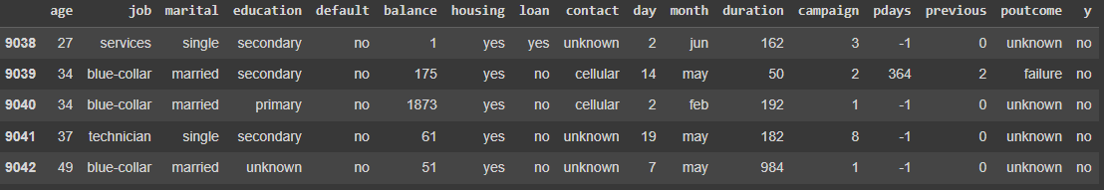
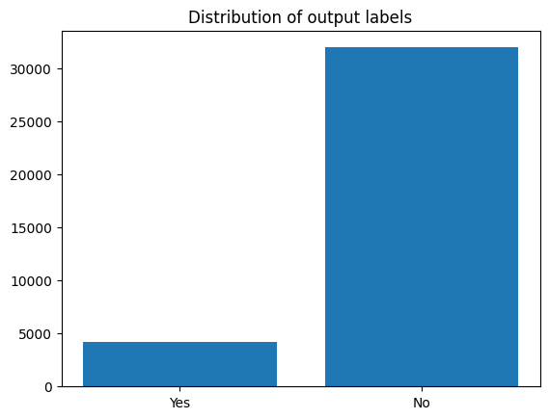
Exploratory Data Analysis
Checking for unbalanced data
11.7% of clients signed up for the term deposit (y variable)
Checking for missing data
No missing data was found
Notes:
Firstly, we did a check for unbalanced data and found large imbalance for the amount of clients who signed up for the term deposit (y variable)
Also did an exploratory check for missing data and none was found, therefore a robust dataset

Slide 7
Exploratory Data Analysis
Unbalanced data in attributes
‘contact’
‘pdays’
‘poutcome’
‘previous’
28.9%
Of data unknown
82%
Of clients not previously contacted
82%
Of unknown outcome of previous campaign
82%
Of 0 number of contacts performed for the campaign and client
Notes:
Out of this, we discovered that ¼ of the contact column was unknown

Slide 8
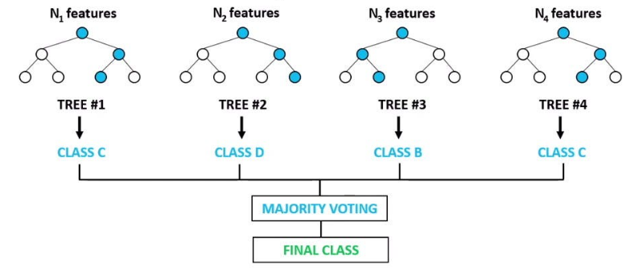
Study Summary
Model Chosen:
Out of 5 models tested, Random Forest Classifier was best.
Feature Importance:
Month and Duration of the call seems to affect the results.

Slide 9
Data Pre-processing

Slide 10
Data Pre-processing
Dropped Features:
The poutcome feature was dropped as more than half of its values are “unknown”.
Data replacement:
All “unknown” data points were replaced with NaN to further emphasize that “unknown” should not be treated as a data value, but rather the lack of data.
Notes:
poutcome feature was dropped as more than half of its values are “unknown” and would hence have little discriminating power. Imputations would also possibly lead to poor results due to a lack of known data. Other features such as pdays were retained as 0 in that case had a definite meaning and does not indicate lack of knowledge
All “unknown” data points were replaced with NaN to further emphasize that “unknown” should not be treated as a data value, but rather the lack of data. This would also aid in data imputation later on.

Slide 11
Data Pre-processing
Encoding:
Ordinal features were encoded according to their order. (Jan → 1, Feb → 2)
Nominal features were encoded using one-hot encoding. In order to ensure independence of features as much as possible, each nominal feature consisting of n values where encoded to n-1 columns.
Labels were encoded according to the convention of No → 0, Yes → 1
Education
Primary
Secondary
Tertiary
Education_secondary | Education_tertiary | Education_primary
0 | 0 | 1
1 | 0 | 0
0 | 1 | 0

Slide 12
Data Pre-processing
Data Imputation:
KNN imputer was used, and NaN values were replaced with the value of its closest neighbour.
Data scaling:
Data points were scaled using a MinMaxScaler to all fall within the range of [0, 1]. Data was fitted onto only training data for fair comparison.
Oversampling:
SMOTE: draws a line to each of the 5 nearest neighbours and generates a random point on each line as a new sample.
ADASYN: similarly to smote focuses oversampling at regions where samples are difficult to classify if nearest neighbour were to be used.
Notes:
Due to a large class imbalance between the positive and negative classes, oversampling was used to ensure even split among both classes and unbiased training

Slide 13
Models
Notes:
Thanks.. I will now be describing the models we selected for our training

Slide 14
Selected Models
1. Decision Tree Classifier
2. AdaBoost Classifier
3. Random Forest Classifier
4. Logistic Regression
5. Multi-Layer Perceptron (MLP) Classifier
Notes:
Overall, we use these 5 models, namely …

Slide 15
Model Summary
Model | Description | Parameters Used
Decision Tree Classifier | A model that predicts the value of a target variable by learning simple decision rules inferred from the data features | Default values are used for all parameters
AdaBoost Classifier | A meta-estimator that begins by fitting a classifier on the original dataset and then fits additional copies of the classifier on the same dataset but where the weights of incorrectly classified instances are adjusted such that subsequent classifiers focus more on difficult cases | Maximum number of estimators at which boosting is terminated = 50 Default values are used for the remaining parameters
Random Forest Classifier | A meta estimator that fits a number of decision tree classifiers on various sub-samples of the dataset and uses averaging to improve the predictive accuracy and control over-fitting | Number of trees in the forest = 50 Function to measure quality of split = entropy Default values are used for the remaining parameters
Notes:
Let me bring you through a brief outline of what each model does. (start w decision tree, then move up)
The parameters used for the model is also displayed on the slide against the model available from the sklearn library.

Slide 16
Model Summary
Model | Description | Parameters Used
Logistic Regression | A model that predicts the probability of an instance belonging to a particular class or not | Maximum number of iterations = 500 Default values are used for the remaining parameters
Multi-Layer Perceptron (MLP) Classifier | Consists of multiple layers of interconnected artificial neurons, which receives input signals, applies a non-linear activation function, and passes the transformed output to the next layer, until the final layer, which produces the classification output | Hidden layer size = (16, 8, 4, 2) Maximum number of iterations = 500 Early stopping is implemented Default values are used for the remaining parameters
Notes:
Explain.
I will now pass the time to XIn Yu to discuss the metrics used and the results we obtained.

Slide 17
Metrics
1. Accuracy
2. Precision for the ‘yes’ class
3. Recall for the ‘yes’ class
4. F-measure for the ‘yes’ class
5. Micro-average F-measure
6. Macro-average F-measure
7. Matthews correlation coefficient (MCC)
We use 5 random seeds to conduct the experiment 5 times and we report the results as mean ± standard deviation
Notes:
To evaluate our models, we used a variety of metrics as shown, such as accuracy and F measure, to gain a more holistic view of the results of the models.
For each model, we run 5 experiments and find the mean and standard deviation of these metrics used across the experiments. This is done to ensure our results are reliable and does not have too significant of a variance.

Slide 18
No Oversampling vs SMOTE vs ADASYN
Oversampling Technique | Effect on results
No Oversampling | Very high precision and accuracy. Very low recall and F measure.
SMOTE | Gives more balanced results. Results do not differ by much compared to ADASYN.
ADASYN | Gives more balanced results. Results do not differ by much compared to SMOTE.
Notes:
Before moving on to our final results, We also ran experiments to see if oversampling had an effect on the results, and if so, which oversampling technique is better.
From the experiments, we found that without oversampling, we are able to get very high precision and accuracy scores, at the expense of very low recall and F measure scores. This isn’t good since this shows that the models have a high false negative rate and thus is bias to predict ‘no’.
With oversampling, we are able to get more balanced results, with better recall and F measure scores. Between SMOTE and ADASYN, results do not differ much. We thus arbitrarily chose SMOTE to use to generate our final results.

Slide 19
Model Evaluation
N=5, Mean ± Std_Dev
Model | Accuracy | Precision | Recall | F Measure | Macro F Measure | Micro F Measure | MCC
Random Forest Classifier | 0.89 ± 0.001 | 0.52 ± 0.004 | 0.61 ± 0.006 | 0.56 ± 0.004 | 0.75 ± 0.002 | 0.88 ± 0.001 | 0.50 ± 0.005
AdaBoost Classifier | 0.86 ± 0.001 | 0.44 ± 0.003 | 0.67 ± 0.006 | 0.53 ± 0.002 | 0.72 ± 0.001 | 0.86 ± 0.001 | 0.47 ± 0.003
Decision Tree Classifier | 0.86 ± 0.001 | 0.42 ± 0.004 | 0.53 ± 0.009 | 0.47 ± 0.006 | 0.69 ± 0.003 | 0.86 ± 0.001 | 0.39 ± 0.007
Logistic Regression | 0.80 ± 0.0006 | 0.35 ± 0.0008 | 0.76 ± 0.001 | 0.48 ± 0.0006 | 0.68 ± 0.0005 | 0.80 ± 0.0006 | 0.42 ± 0.0006
Multi-Layer Perceptron (MLP) Classifier | 0.84 ± 0.004 | 0.40 ± 0.007 | 0.72 ± 0.01 | 0.51 ± 0.007 | 0.71 ± 0.004 | 0.84 ± 0.004 | 0.46 ± 0.009
Notes:
This is our final results, with each row being a different model, and each column being an evaluation metric used. Scores are shown along with their standard deviation, with the highest scores for each metric highlighted in bold. From a quick glance, you can see that the Random Forest model gives the best results on almost all evaluation metrics, except recall where it is the 2nd lowest.
This shows that Random Forest should be the model of choice among the 5 models we tried in most cases. However, if we want to minimize the False Negative rate of the prediction, then we can consider using another model such as the Logistic Regression, at the cost of lower scores across other metrics.
In the case of the bank’s marketing campaign, high precision may be preferred over high recall, since the bank will want to maximize client subscription rate with the given fixed manpower of the campaign.

Slide 20
Summary
Notes:
Now, we will summarise the findings thus far.

Slide 21
Best model: Random Forest Classifier
Random Forest Classifier, AdaBoost, Decision Tree, Logistic Regression, Multilayer Perceptron
Strengths of Random Forest Classifier
Ensemble Averaging vs Decision trees
Robustness to noisy data vs Decision trees
Nonlinearity handling vs MLP and Logistic Regression
Versatility vs AdaBoost, Decision trees and MLP
Notes:
Our best performing model is the Random Forest classifier.
Let's delve into why the Random Forest Classifier performed better than the other models (AdaBoost, Decision Tree, Logistic Regression, and MLP) in your specific scenario:
Ensemble Averaging: Random Forest is an ensemble of decision trees, which helps mitigate overfitting. It averages out the predictions from multiple trees, reducing the risk of capturing noise in the data. In contrast, Decision Tree are sensitive to noisy data and prone to overfitting, which can lead to poor generalization. Random Forests can mitigate this effect.
Nonlinearity Handling: Random Forest can capture nonlinear relationships effectively, as it combines multiple decision trees, each of which can capture different aspects of nonlinearity. MLP (Multi-Layer Perceptron) also has the capacity to capture nonlinear patterns but may require more extensive tuning and data preprocessing. Additionally, Logistic Regression, which is a linear model, assumes a linear relationship between features and the target. If the true relationship is nonlinear, Logistic Regression can introduce bias in predictions. Random Forest is more flexible in capturing both linear and nonlinear relationships.
Versatility: Random Forest is versatile and generally performs well across different types of datasets without extensive hyperparameter tuning. AdaBoost, Decision Tree, and MLP may require more careful tuning to achieve comparable performance.

Slide 22
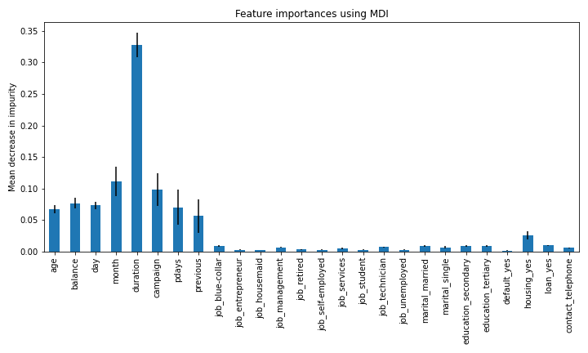
Feature Importance
We consider the best performing model in our random forest classifier
The feature importance is computed as the mean and standard deviation of accumulation of the impurity decrease within each tree (MDI: mean decrease in impurity)
Notes:
For the random forest classifier, we plotted the mean decrease in impurity or MDI for each feature to investigate feature importance.
The MDI is computed as the mean and standard deviation of the accumulation of the impurity decrease within each tree.
From this plot, we can see that the month and duration features have the highest MDI and are thus the two most important features in the dataset.

Slide 23
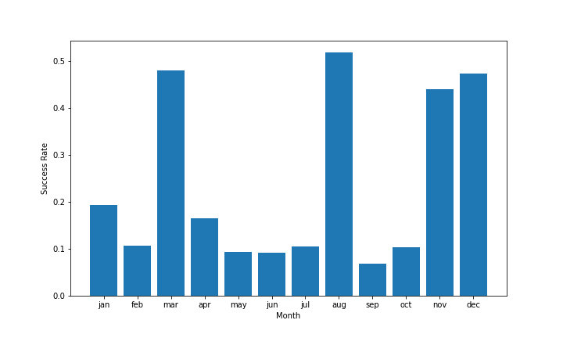
Feature Importance
2 most relevant features: duration and month
Longer calls tend to increase success
Calling during certain months may tend to increase success
Notes:
For duration, we can very easily see a logical explanation as to its importance. Naturally, when you are on a call with the bank agent, if you are not interested in subscribing to a term deposit, you would end the call sooner. Conversely, if you are on the call for a long time, you are most likely interested and thus expected to be more likely to subscribe to a term deposit.
For month, we plotted a bar plot of the target y against months. We can see that there is an uneven distribution of term deposit subscriptions, with the months March, August, November and December having the highest subscriptions. This uneven nature implies that there is much to learn from this feature as an unimportant feature would have a fairly even distribution.

Slide 24
Recommendations
Notes:
Now, let me share some of our recommendations on how to improve our results.

Slide 25
Model
More ensemble learning techniques (E.g. XGBoost vs Random Forest and AdaBoost)
Faster
Better at modelling nonlinear r/s
Less sensitive to noisy data
Performs better with default hyperparemeters
Avoid working with deep learning models
Data is very small - only 17 features
Notes:
We should continue to leverage ensemble methods, such as Random Forest, but also explore more advanced ensemble techniques like Gradient Boosting (e.g., XGBoost or LightGBM) or stacking. Ensembles can often provide a boost in predictive performance. Currently, we only experimented with Random Forest and AdaBoost methods.
AdaBoost is generally slower than Gradient Boosting and XGBoost, as it requires multiple iterations to build the sequence of models.
Moreover, XGBoost is Better at modelling nonlinear relationships, less sensitive to noisy data and also performs better with default hyperparemeters, thus allowing for faster training.
Additionally, due to the small size of the data having only 17 features, it may not be worthwhile to explore traditional deep learning methods as these models usually only work well with data of huge sizes, for example images or text in the field of Natural Language Processing.

Slide 26
Data
Feature selection
Explore other methods if possible
Random forest performance deproved after using only best 10 features
Pearson r values suggest features have nonlinear relationship with target variable y
Small number of features make it difficult
Feature engineering
Language models to extract meaningful features from text data
Polynomial feature engineering
Notes:
For Data, we could explore more feature selection methods if possible. We tried to select the best features from the dataset by looking at the Pearson correlation of each feature and the target variable, but the r values were very low which suggest that the features most likely have a non-linear relationship with the target variable. We also tried selecting the best 10 features from our dataset for the modelling but noticed that performance of the Random Forest classifier was worse than just using all features.
This may be difficult due to the small number of features in the dataset.
We should also explore advanced feature engineering techniques specific to this domain. For example, if working with text data, we can consider using word embeddings or language models like BERT to extract more meaningful features.
Another method could be Polynomial Features: Creating polynomial features by raising numerical features to various powers. This can capture higher-order relationships. The degree of the polynomial is used so as to control the number of features added. When a degree of 3 is used, it will add two new variables for each input variable.

Slide 27
Thank you!

